Slide 1


Loan Approval Prediction Using Machine Learning
Under the Guidance of
Prof.
Assistant Professor,
Dept. of CSE
Presentation By:
Name USN

Slide 2
AGENDA
Introduction
Objective or Aim
Existing System (Problem Identification)
Proposed System
System Design
Methodology
Implementation
SRS
Conclusion
Feature Enhancement

Slide 3
ABSTRACT

Slide 4
ABSTRACT
With the increase in banking sector many people are applying for loans in bank. All these loans are n
The main income of bank assets comes from gain earned from loans. The main objective of banks is to invest their assets in safe customers.
Therefore it is important to apply various techniques in banking sector for selecting a customer who pays loan on time.
A very important approach in predictive analytics is used to study the problem of predicting loan defaulters.
Experimental tests found that the Logistic Regression model has better performance than other models in terms of loan prediction.

Slide 5
INTRODUCTION

Slide 6
Introduction
Loan Prediction is very helpful for employee of banks as well as for the applicant also. Customer first apply for loan after that company or bank validates the customer eligibility for loan.
Company or bank wants to automate the loan eligibility process (real time) based on customer details provided while filling application form. These details are Gender, Marital Status, Education, Number of Dependents, Income, Loan Amount, Credit History and other.
. This project has taken the data of previous customers of various banks to whom on a set of parameters loan were approved. So the machine learning model is trained on that record to get accurate results.
Our main objective of this project is to predict the loan whether loan is approved or not. To predict loan safety, the KNN, SVM and Naïve bayes algorithm are used.

Slide 7
AIM & OBJECTIVES

Slide 8
AIM
The aim of loan approval prediction in machine learning is to develop predictive models that can accurately assess the creditworthiness of loan applicants and predict the likelihood of loan approval.
Objectives of Project:
Data Collection
Data Pre-processing & Feature Extraction
Data Analysis
Building Machine Learning Models : SVM, LR, KNN & NB
Model Evaluation
Web application to demonstrate the result/prediction (approved or Not)

Slide 9
EXISTING SYSTEM

Slide 10
Till now loans are processed by various banks through pen and paperwork. When the large no of customers apply for bank loan these bank take lot of time to approve their loan. After approval of loan by the banks, there is no surety that the chosen applicant is capable of paying loan or not.
Many banks use their own software’s for the loan approval. In existing system we use data mining algorithms for the loan approval; this is the old technique for the approval of loan.
Mutiple data sets are combined and form a Generalised datasets, and different machine learning algorithms are applied(Navie Bayes, Super Vector Machine, KNN)to generate results. But these techniques are not up to the mark. Due to this huge banks are suffering from financial crises. To resolve this issue we introduce a new way for approval of loans.

Slide 11
PROPOSED SYSTEM

Slide 12
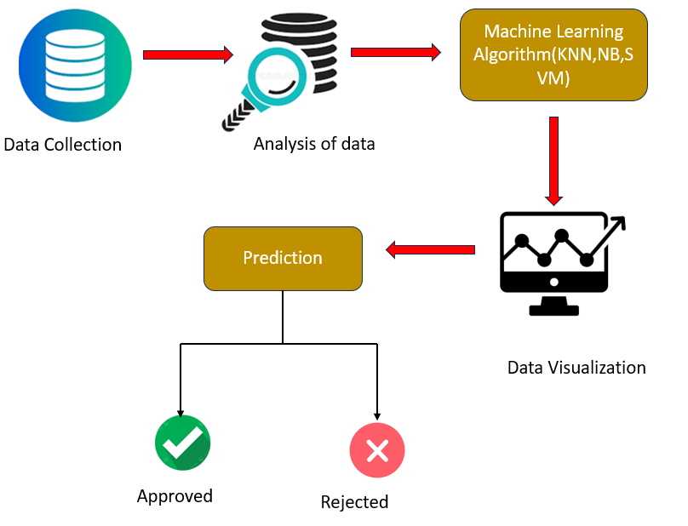

Slide 13
SYSTEM DESIGN

Slide 14
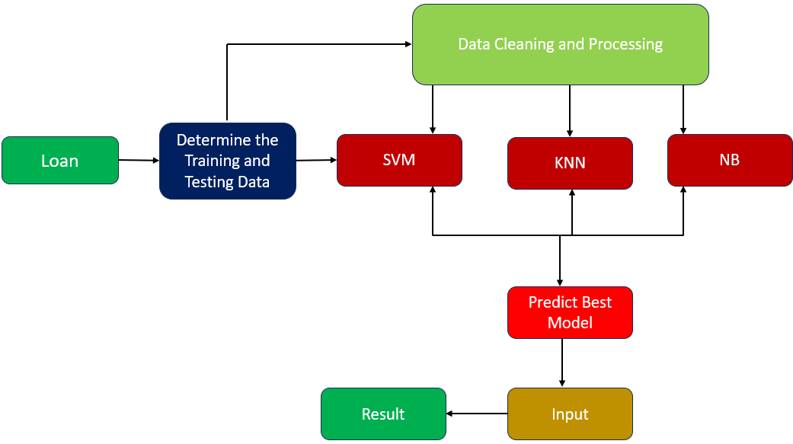
Architecture Diagram

Slide 15
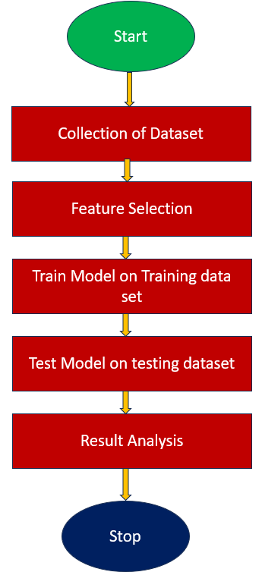
Flow Chart

Slide 16
METHODOLOGY

Slide 17
METHODOLOGY
This system predict whether the loan is approve or reject. This System refers the following things or ways.
Steps:
Data Collection
Analysis of Data
Model Selection and Creation
Performance Evaluation
Prediction and Result

Slide 18
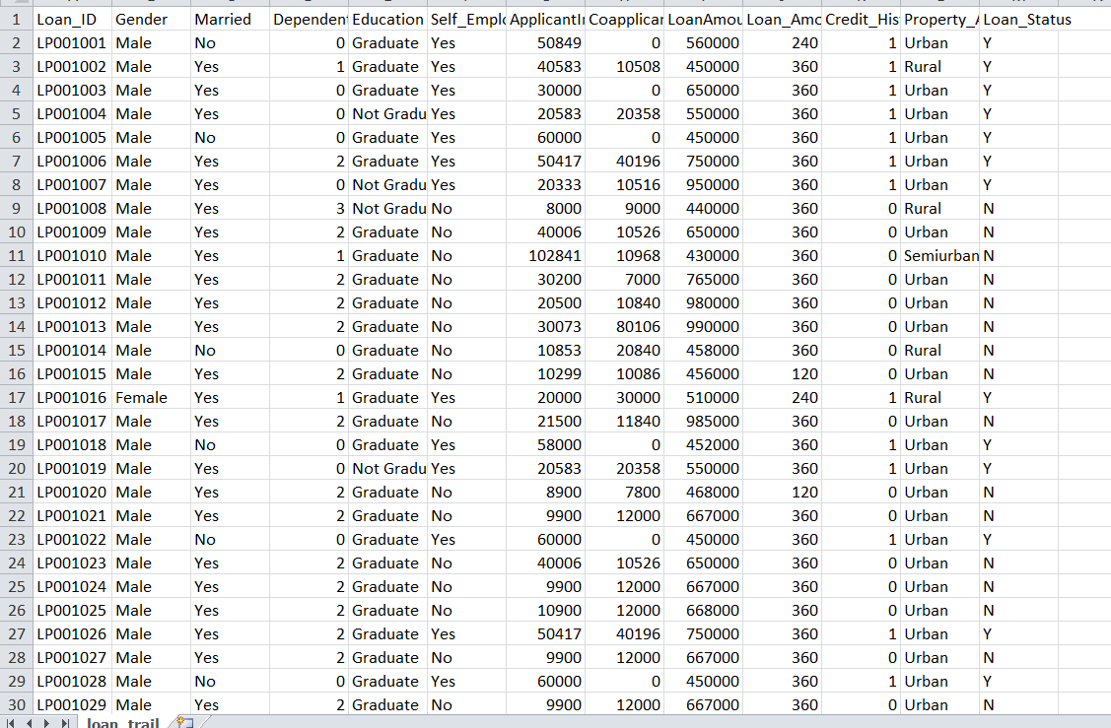
Step 1: Data Collection
Data collection in loan approval involves gathering relevant information about loan applicants to assess their creditworthiness and make informed decisions regarding loan approval.
Data Collection refers to the process of gathering and preparing a dataset that will be used to train a machine learning model.

Slide 19
Step 2: Data Cleaning & Analysis of Data
Data Cleaning is one of the pre-processing steps to clean the dataset. In this phase, we are so many methods to clean the data are
Finding Null Values
Checking about datatype of attribute
Feature Extraction
Checking Outliers
After the data is cleaned. Then we can Exploratory data analysis on data and represent the data graphically.
The analysis of data on loan approval prediction aims to uncover patterns, relationships, and insights that can inform loan approval decisions and improve the accuracy of predictive models.
It helps lenders understand the factors that contribute to loan approval outcomes and assists in making informed decisions regarding loan applications and prediction involves examining and extracting insights from the collected data to understand patterns, relationships, and factors that contribute to loan approval decisions.

Slide 20
Step 3: Model Selection and Creation
Model selection in loan approval prediction involves choosing the most appropriate machine learning algorithm or model that can effectively predict loan approval outcomes based on the available data.
Ultimately, the selection of a model for loan approval prediction should be based on a comprehensive evaluation of factors such as problem complexity, data characteristics, interpretability requirements, performance metrics, and validation techniques. It's advisable to experiment with different models and techniques to find the optimal balance between performance, interpretability, and practical applicability within the loan approval context.
Here, we build the
Support Vector Machine (SVM)
K Nearest Neighbour (KNN)
Naïve Bayes Classifier (NB)
Logistic Regression (LR)

Slide 21

Step 4: Performance Evaluation
Here, we calculate the performance of all the models used in this loan approval prediction.
Evaluate :
Accuracy of both train and test model

Slide 22
Step 5: Prediction & Result
The prediction of loan approval involves using machine learning techniques to build models that can predict the loan is approved or not based on relevant features and historical data.
During our evaluation, we achieved that Logistic Regression get good accuracy.
So we used LR for deploying a result.\
Here, we developed a interface to show the result of the applicant, whether the person loan is approved or not.

Slide 23
IMPLEMENTATION

Slide 24
Implementation Details
1. Programming Language used : Python Programming
2. Software tools: Anaconda Navigator/ Google Colab /Flask
3. Dataset: Loan Approval Dataset
4. Algorithms: SVM,NB,KNN

Slide 25
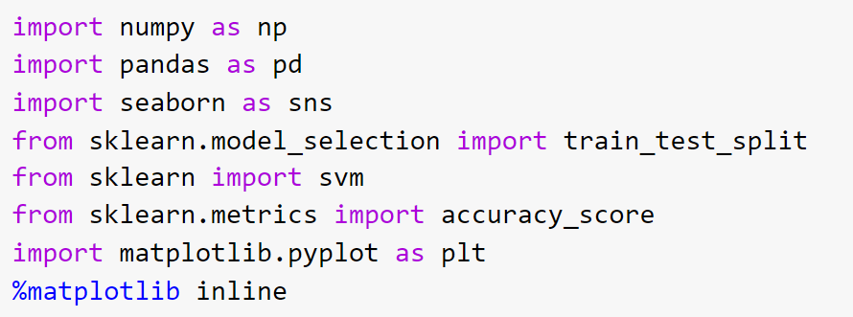
Importing Packages

Slide 26
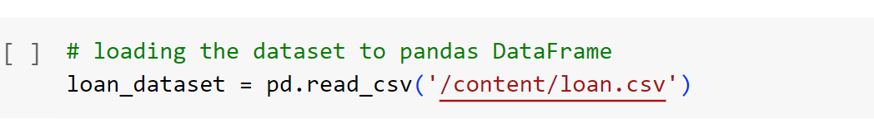
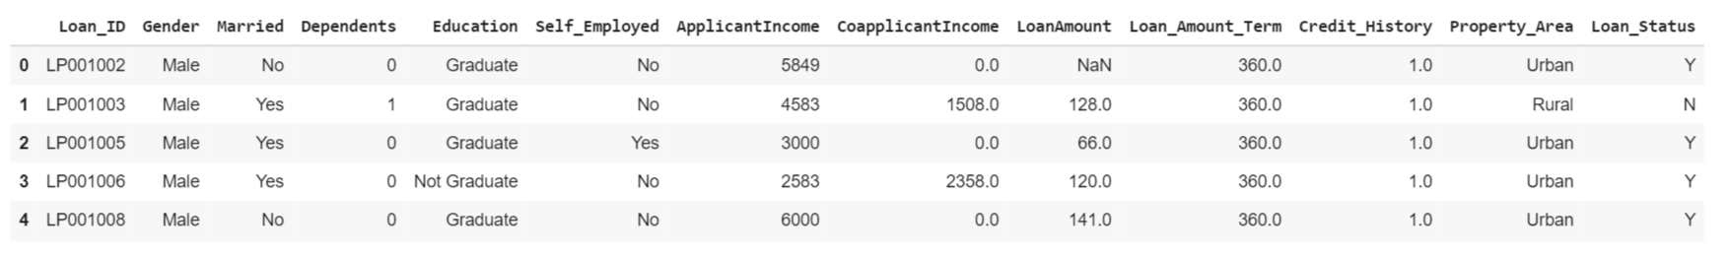
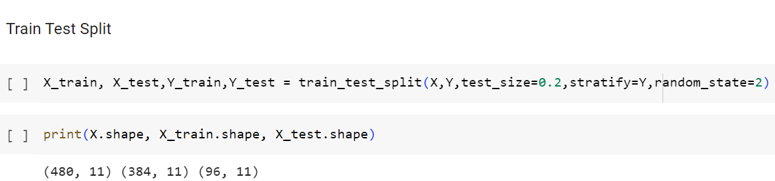
Read Dataset
Split Train and Test Data

Slide 27
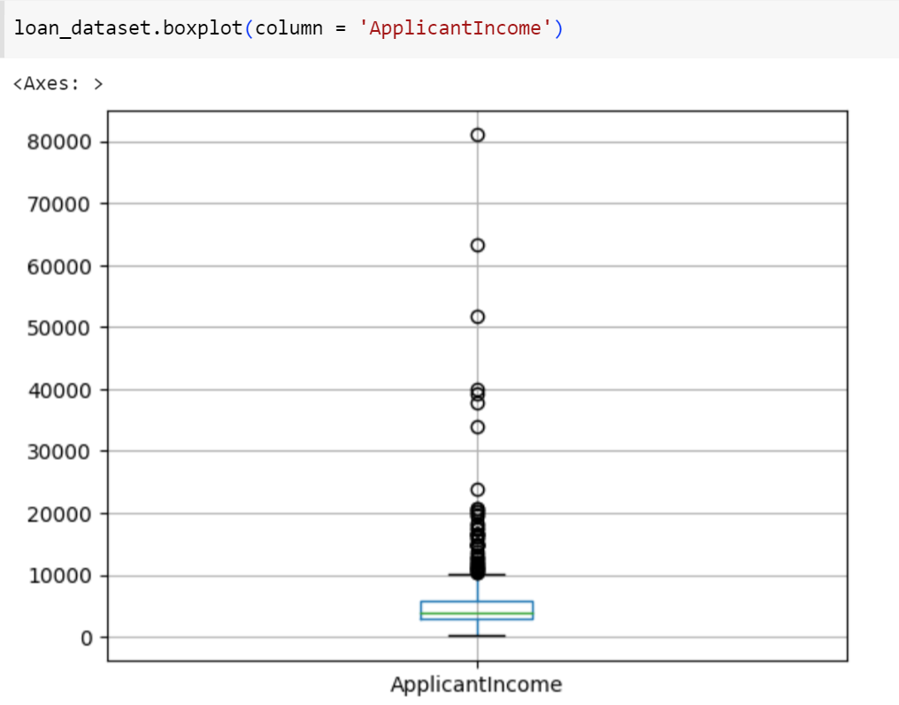
Boxplot for applicant income attribute

Slide 28
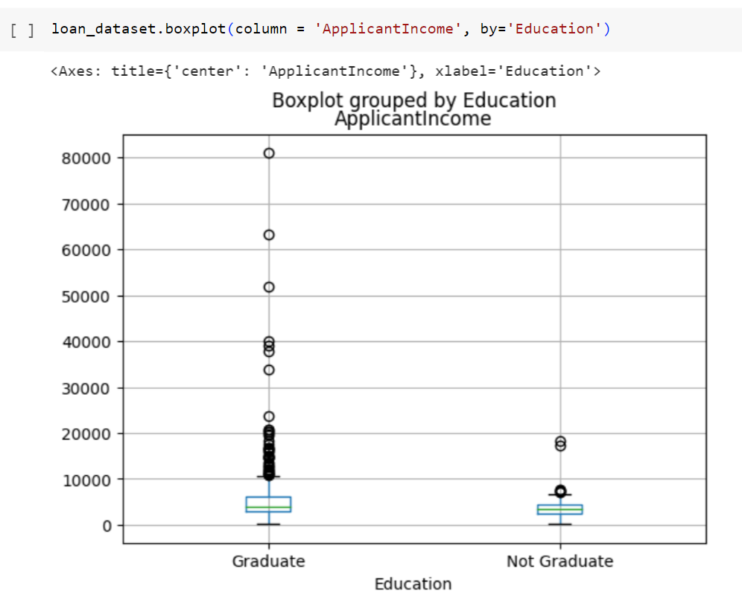
Applicant income vs education

Slide 29
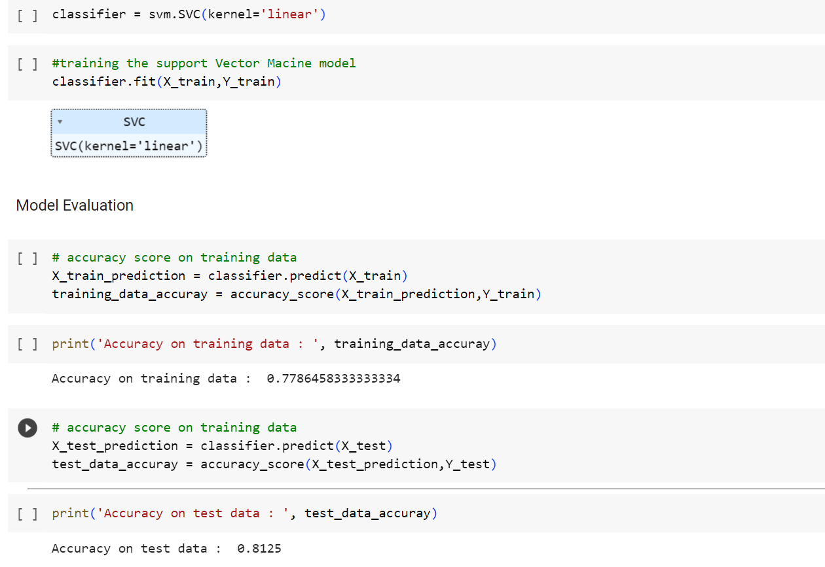
Building Machine Learning Model : 1. SVM

Slide 30
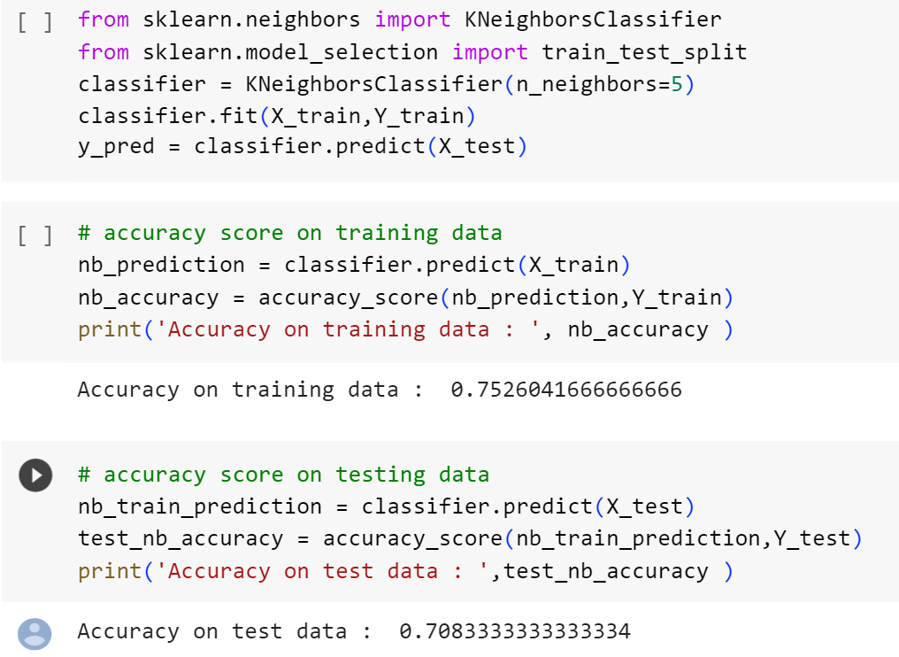
2. KNN

Slide 31
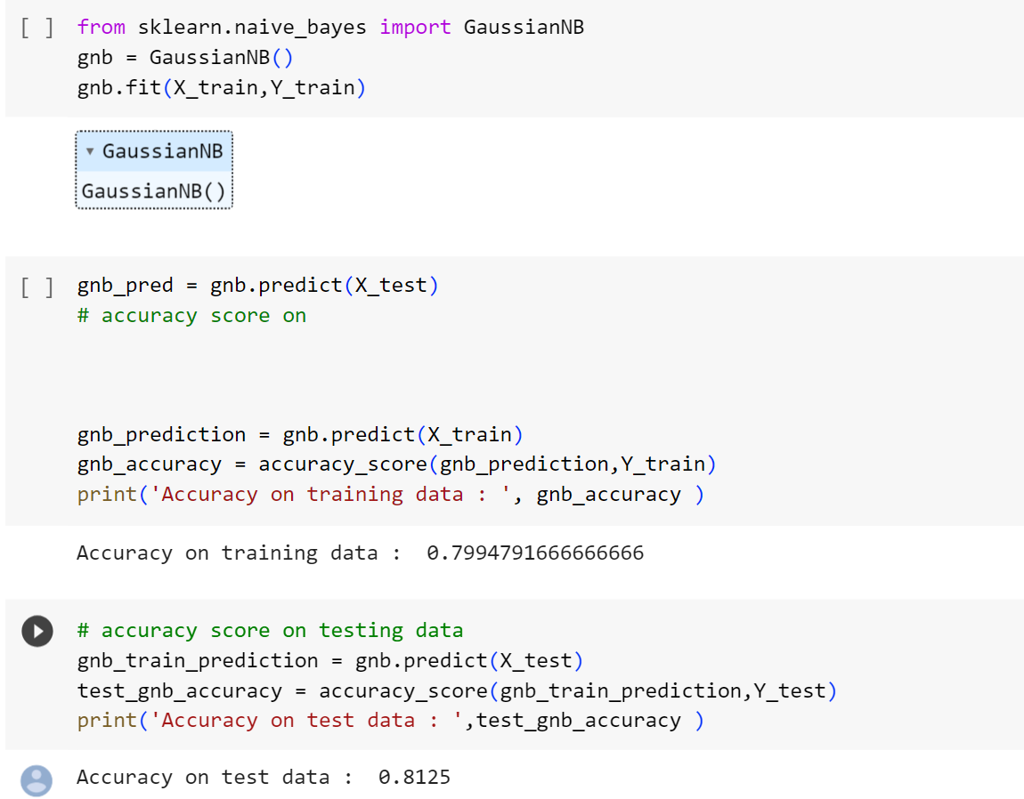
3. Naive Bayes

Slide 32
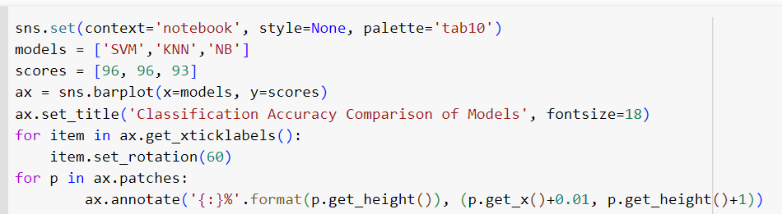
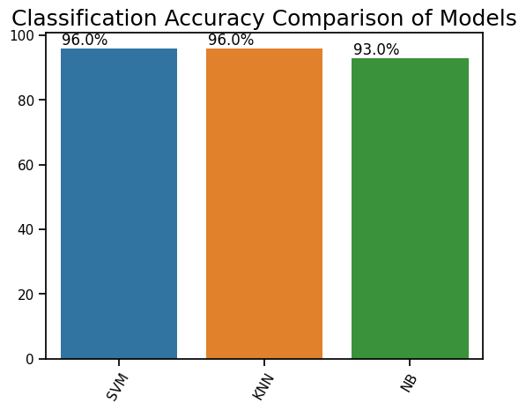
Model Comparison

Slide 33
SYSTEM REQUIREMENT SPECIFICATION(SRS)

Slide 34
System Requirements
Software Requirements
Scripting Tool: Anaconda Navigator (Jupyter Notebook) & Google Colab
Scripting language: Python Programming
Operating System: Microsoft Windows 10 or 11
Dataset: Loan Approval Dataset
Machine Learning Packages : Numpy, Pandas, Matplotlib etc..
Hardware Requirements
Processor : 3.0 GHz and Above
Output Devices : Monitor (LCD)
Input Devices : Keyboard
Hard Disk : 1 TB
RAM : 8GB or Above

Slide 35
CONCLUSION

Slide 36
Conclusion
From the proper view of analysis this project can be used perfect for detection of clients who are eligible for approval of loan. The application can be used for all banking system. Since the technology is moving towards online, this project has more scope for the upcoming days. Here, we used various machine learning model such as NBC, SVM, KNN & LR. It can be concluded with confidence that the Logistic Regression model is extremely efficient and gives a better result when compared to other models with accuracy of 98%. It works correctly and full fills all requirements of bankers. We created graphical interface to demonstrate the result that predicts the loan is approved or reject to loan applicant or customer very accurately.

Slide 37
FUTURE ENHANCEMENT
Feature Engineering: Explore additional data sources and variables that could enhance the predictive power of the model. For example, you could include social media data, transaction history, or alternative credit data to capture a more comprehensive picture of the applicant's financial behaviour.
Advanced Modelling Techniques: Consider using more sophisticated machine learning algorithms or ensemble methods to improve the accuracy of loan approval predictions. Techniques such as gradient boosting, random forests, or deep learning models may yield better results by capturing complex relationships within the data.
Model Monitoring and Updates: Establish a mechanism to continuously monitor the loan approval model's performance and update it as new data becomes available. Regular model evaluations, validation, and recalibration can help maintain accuracy and ensure the model stays relevant over time.

Slide 38


